Slide 1
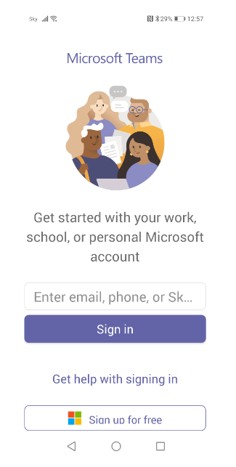
xxxxxx@student.cavc.ac.uk
Click/ጠዉቅ

Slide 2
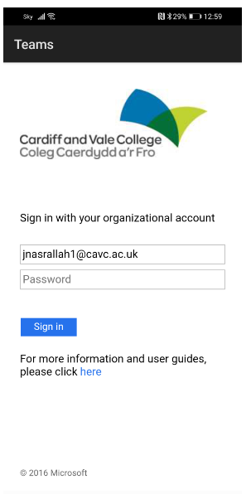
xxxxxx@student.cavc.ac.uk
Enter password/password ኣእቱ
Click/ጠዉቅ

Slide 3
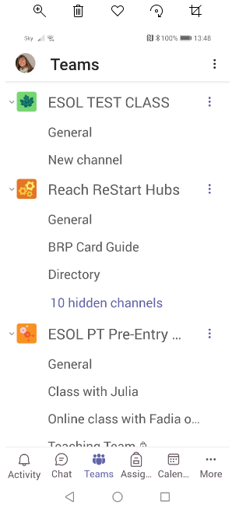
Click on your class
/ኣብ ናትካ ክላስ ጠዉቅ
Click on Teams/ኣብ team ጠዉቅ

Slide 4
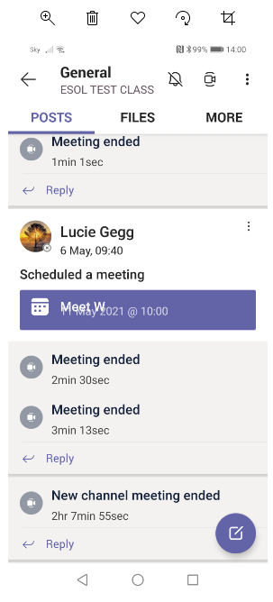
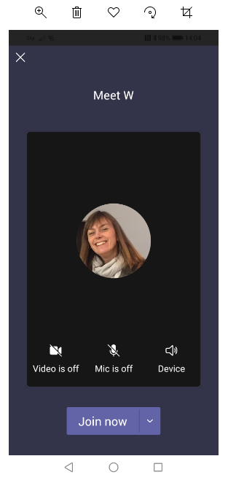
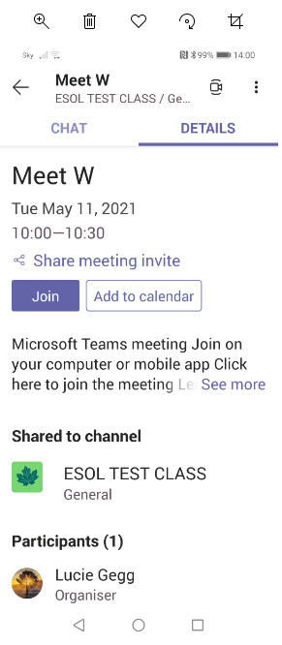
To join a meeting – phone/ንክትጽንበር ኣብ ናይ ቴሌፎን ኣኼባ
Click 1/ጠዉቅ
Click 2/ጠዉቅ
Click 3/ጠዉቅ

Slide 5
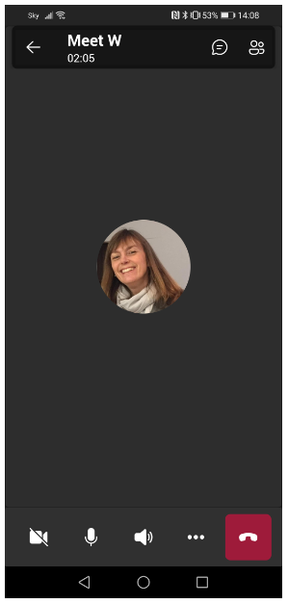
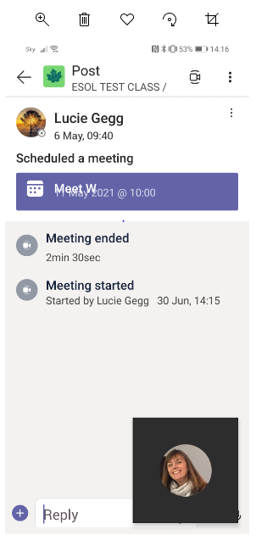
Chat/ዕላል
Camera on/off
ካሜሪ መወልዒ/ መትፍኢ
Type/ምጽሓፍ
Mute/unmute/መዐፈኒ ድምጺ/ መክፈቲ ድምጺ
End call/መዕጸዊ ቴሌፎን

Slide 6
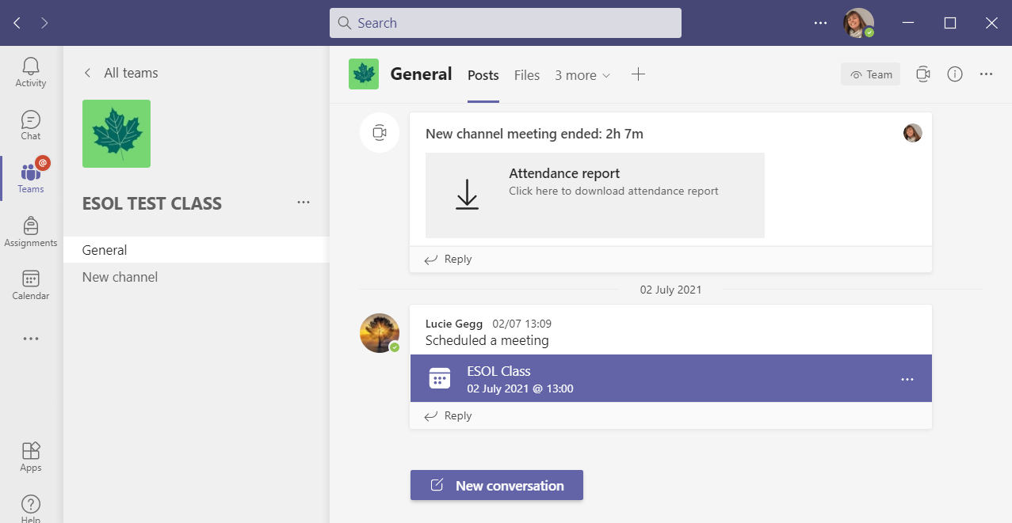
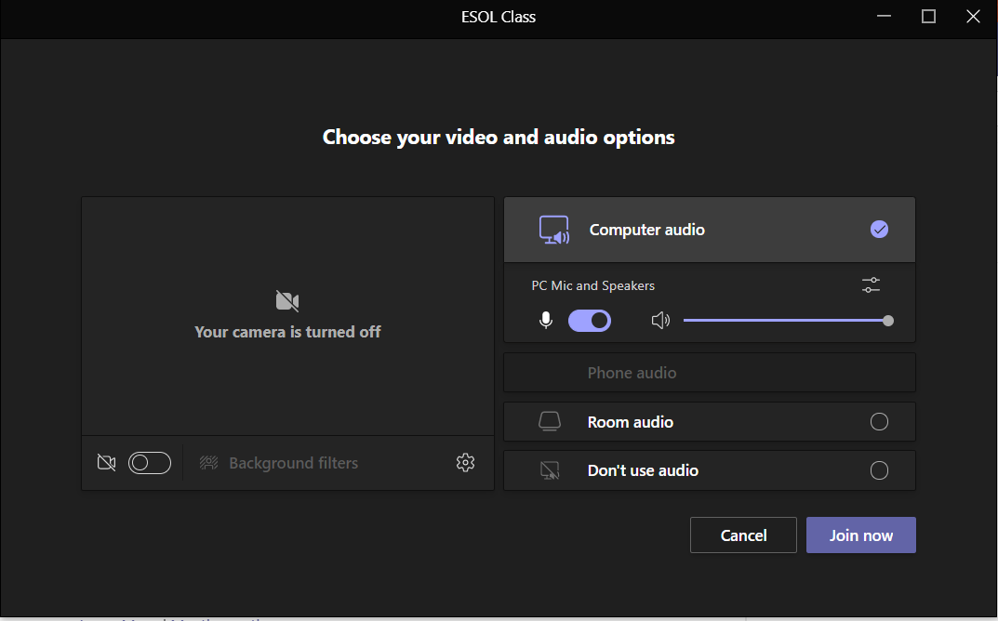
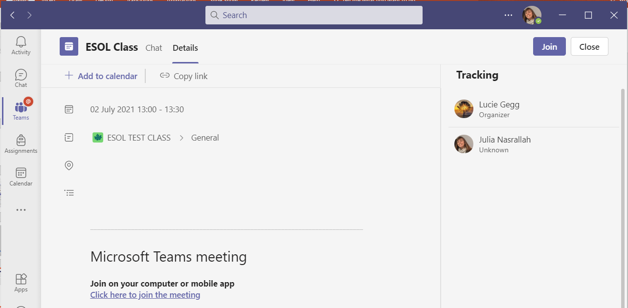
To join a call – laptop/ንክትጽንበር ኢብ ናይ laptop ኣኼባ
Click 1/ጠዉቅ
Click 2/ጠዉቅ
Click 3/ጠዉቅ

Slide 7
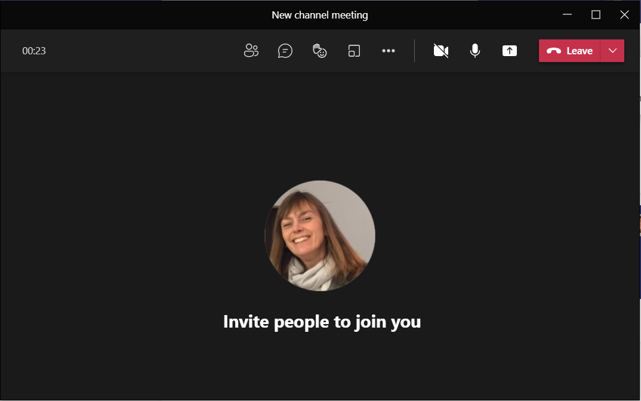
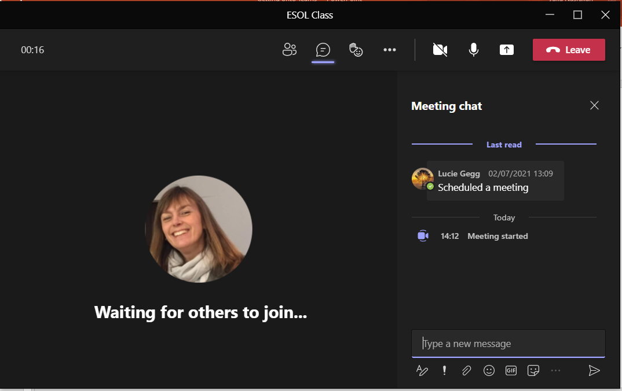
Camera on/off/ካሜሪ መወልዒ/ መትፍኢ
Chat/ዕላል
Mute/unmute/መዐፈኒ ድምጺ/ መክፈቲ ድምጺ
End call/መዕጸዊ ቴሌፎን
Type/ምጽሓፍ

